Slide 1

ASB Team

Slide 2
Atlas Features

Slide 3
Atlas ?
Notes:
What is Atlas ?
->
Why do we need a new Platform ?
Building a web app have 2 options: use a platform, or build your app from scratch.

Slide 4
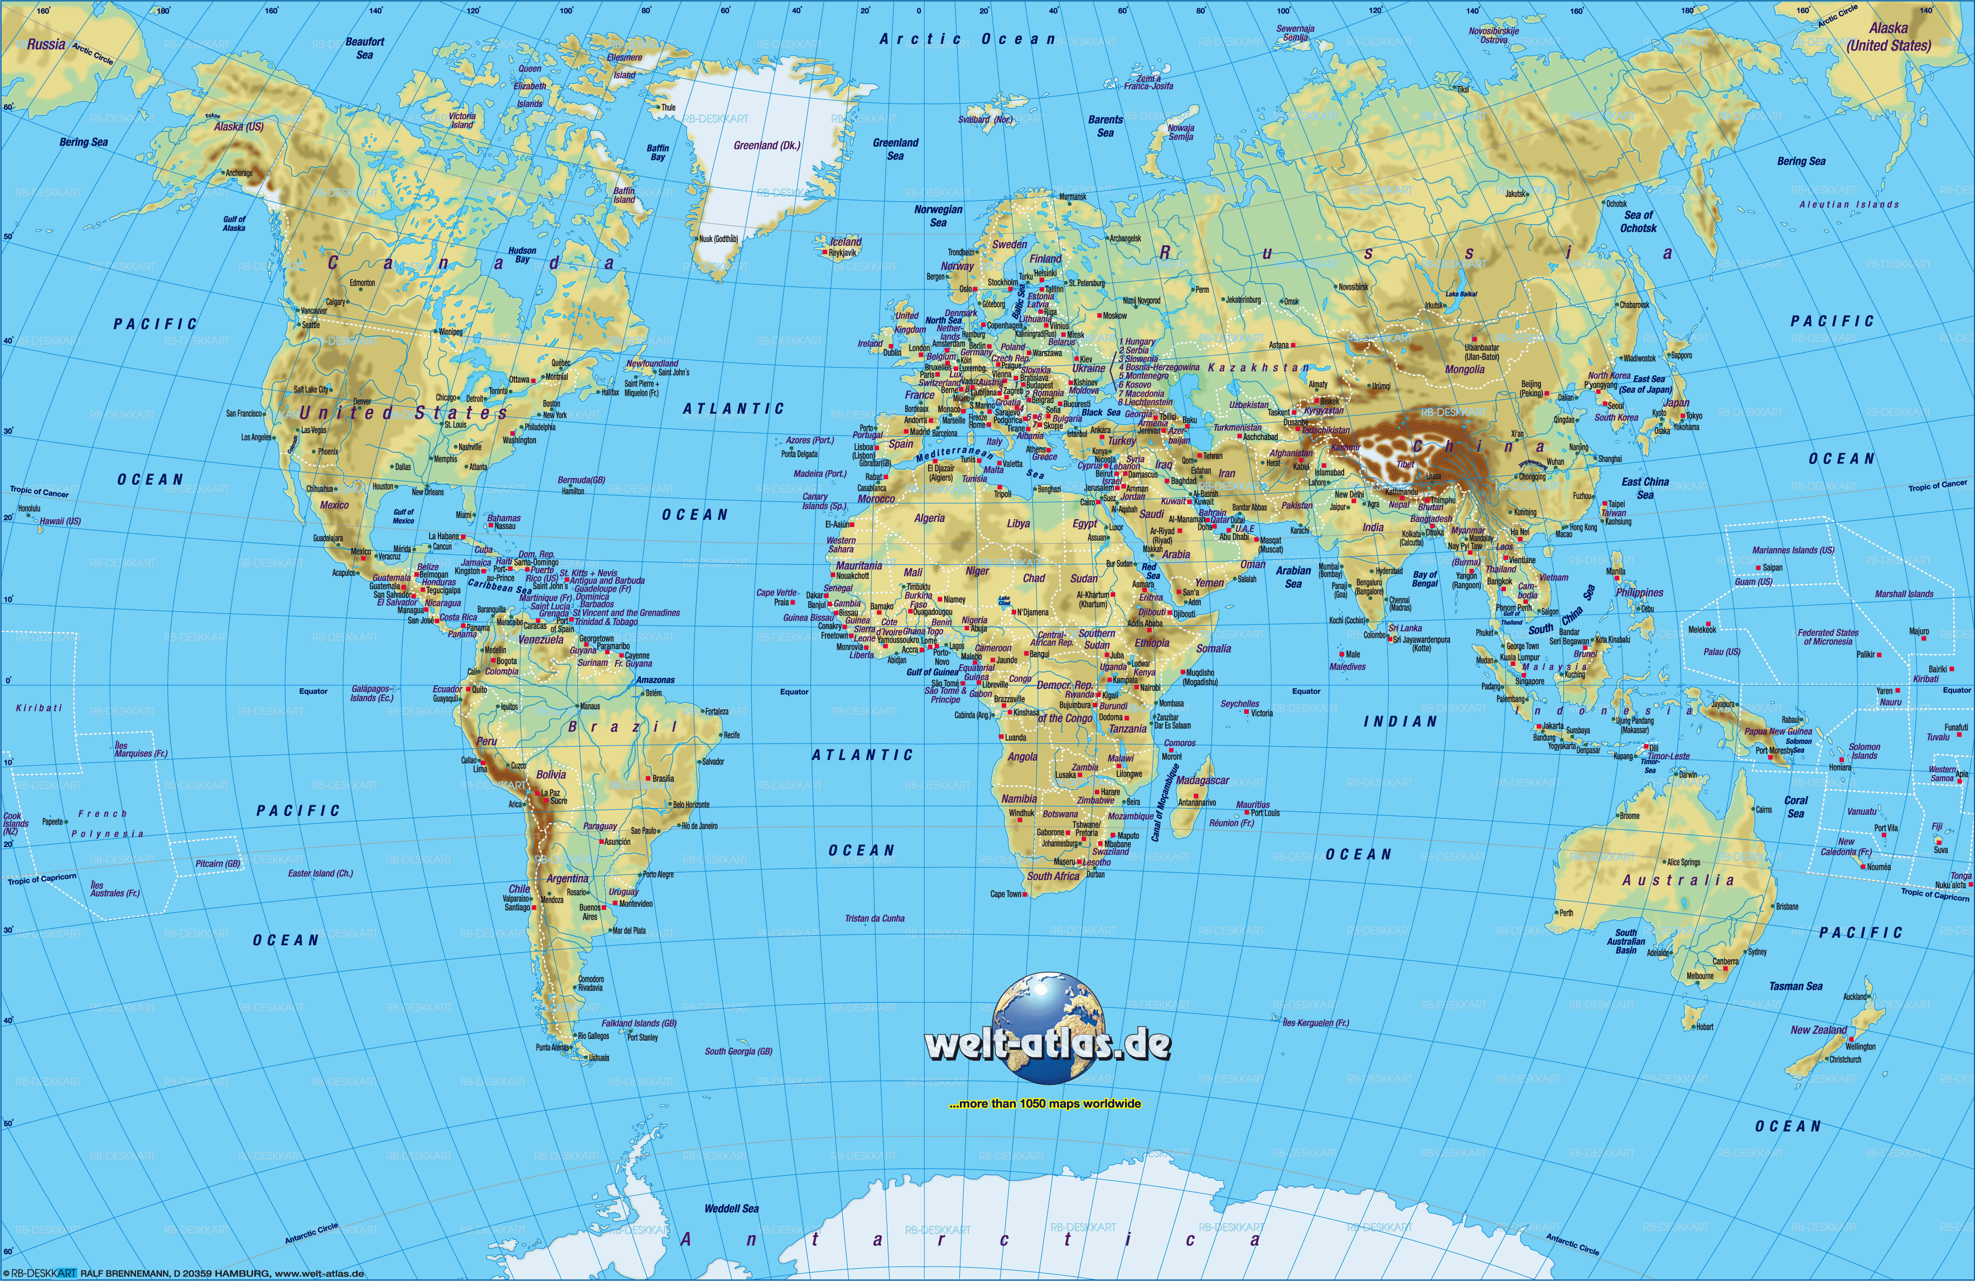
Notes:
This

Slide 5
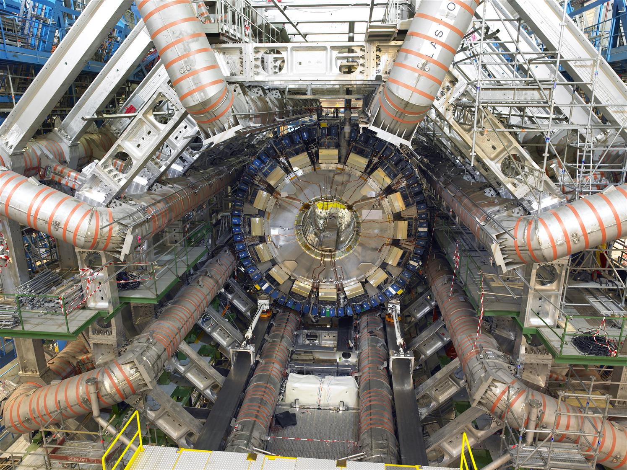
Notes:
That

Slide 6

Notes:
Him

Slide 7


Atlas
ASB’s next-generation platform
Notes:
What is Atlas ?
->
Why do we need a new Platform ?
Building a web app have 2 options: use a platform, or build your app from scratch.

Slide 8

Notes:
Building from scratch: working with lots of small components -> reinventing the wheel

Slide 9

Notes:
Can alleviate problem by combining smaller nuts and bolts into re-usable widgets…

Slide 10

Notes:
…but ideally you want to be scaffolding your application from much larger building blocks (Duplo this case) which take care of the common plumbing concerns: config, logging, authentication, data-access, etc. These building blocks do all the heavy-lifting for your application…

Slide 11

Notes:
…heavy-lifting is one of the main design principals of the Atlas Platform; the platform does the heavy lifting so you can focus on business rather than plumbing.

Slide 12

Notes:
Re-usability is also important. ASP.NET MVC app, pages tightly bound. Only way to move a page is to rip it out.

Slide 13
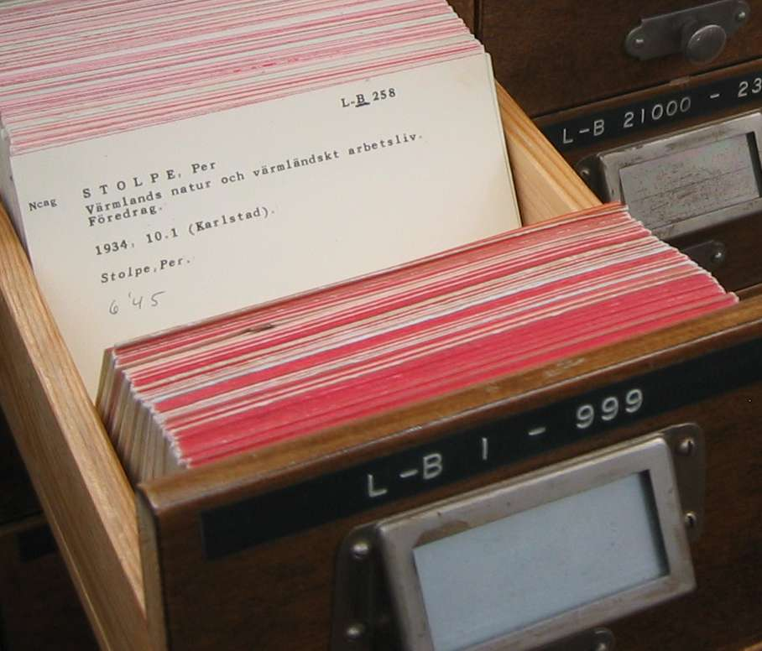
Notes:
Ideally want a more loosely-coupled arrangement which allows features to be re-used between applications.

Slide 14
App Foo
App Bar
Feature 1
Feature 2
Feature 3
Feature 3
Notes:
Atlas allows feature-level re-use by deploying Features as standalone applications. For example…

Slide 15

Customer Service
Account Service
Calendar Control
Product-Request
Service
Products Service
Notification
Service
Addresses Service
Payments Service
Email Question
Text Question
Transfer Service
Notes:
Also have re-usability within features by maintaining a growing repository of re-usable widgets (Lego): for example…

Slide 16

Notes:
Lastly, we want our apps to be responsive; Desktop

Slide 17

Notes:
Tablet

Slide 18

Notes:
Mobile. Good experience…

Slide 19

Notes:
..not so good.

Slide 20
Container
5
1
2
IAM
Platform Services
Feature 1
Feature 2
3
Transactions
Payments
Product-Requests
Accounts
Transfers
Products
…
Feature 3
Layer 7 (APIs)
4
Middleware
HOST
Onyx
Notes:
10,000ft view of the Atlas Platform.
Containers & Features: Containers being a hosting environment for Features.
Platform Services: provides configuration and run-time support for Containers
APIs: RESTful services for providing data to Features.

Slide 21



Development Stack
MVC
Toolkit
Responsive
Containers & Features
Helix
Notes:
Likely suspects in SPA development

Slide 22






Dev-ops
Source Control
Build Automation
Release Management

Slide 23
My ASB
Notes:
Pilot Atlas application. Eventual replacement to FNC.

Slide 24
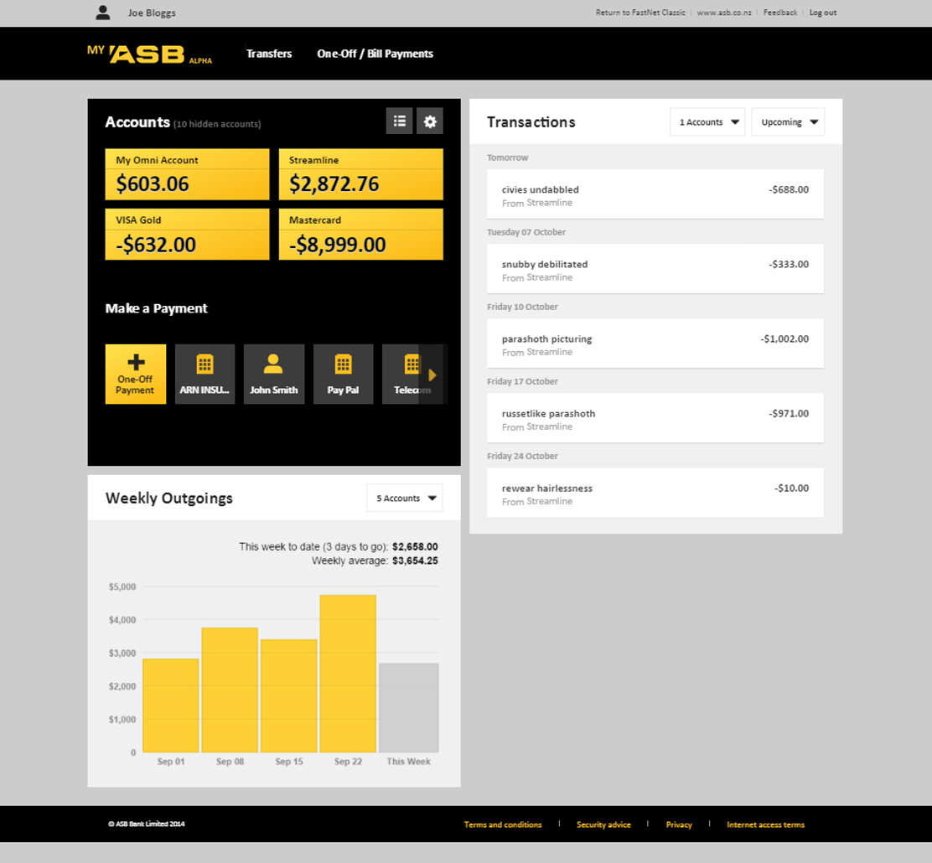
1
2
3
Notes:
Home page, 3 Features. Note, each Feature deployed and versioned independently.

Slide 25
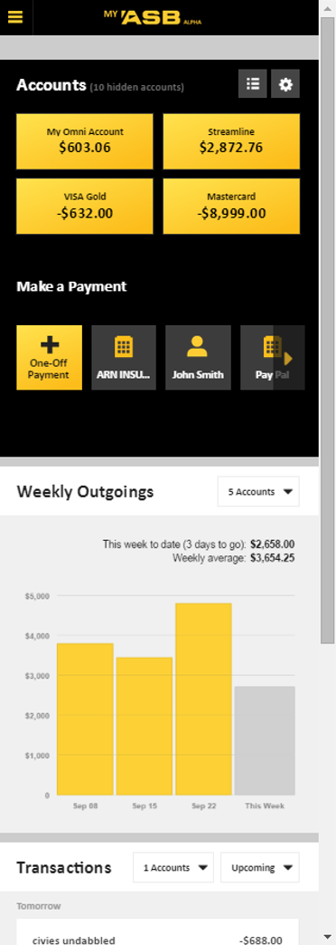
1
2

Slide 26
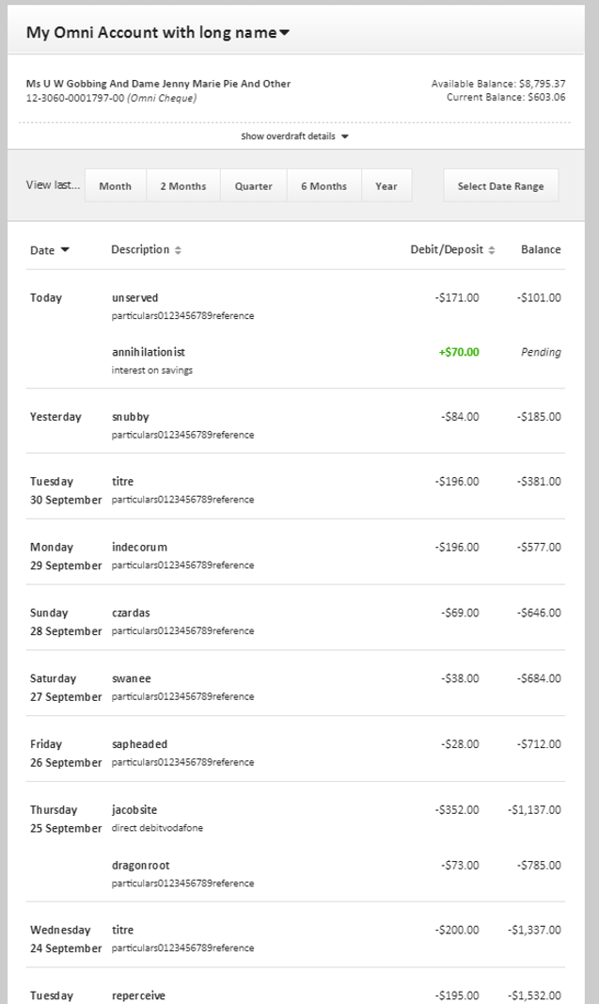

Slide 27
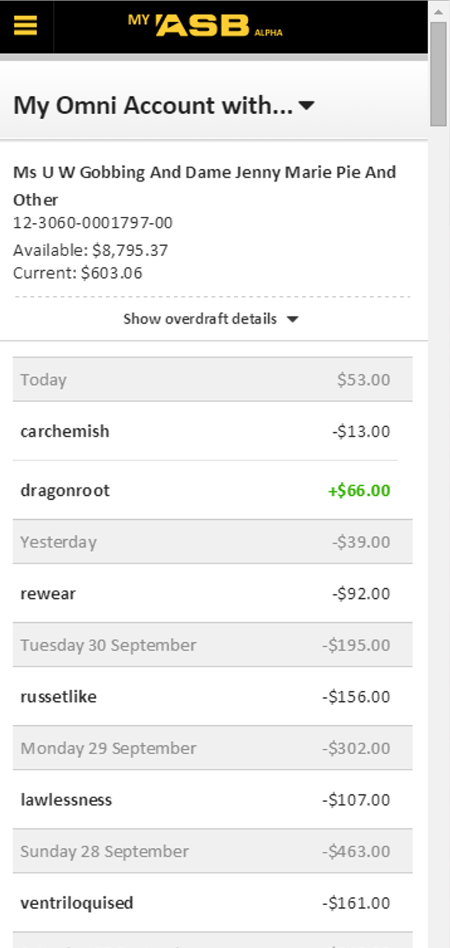

Slide 28
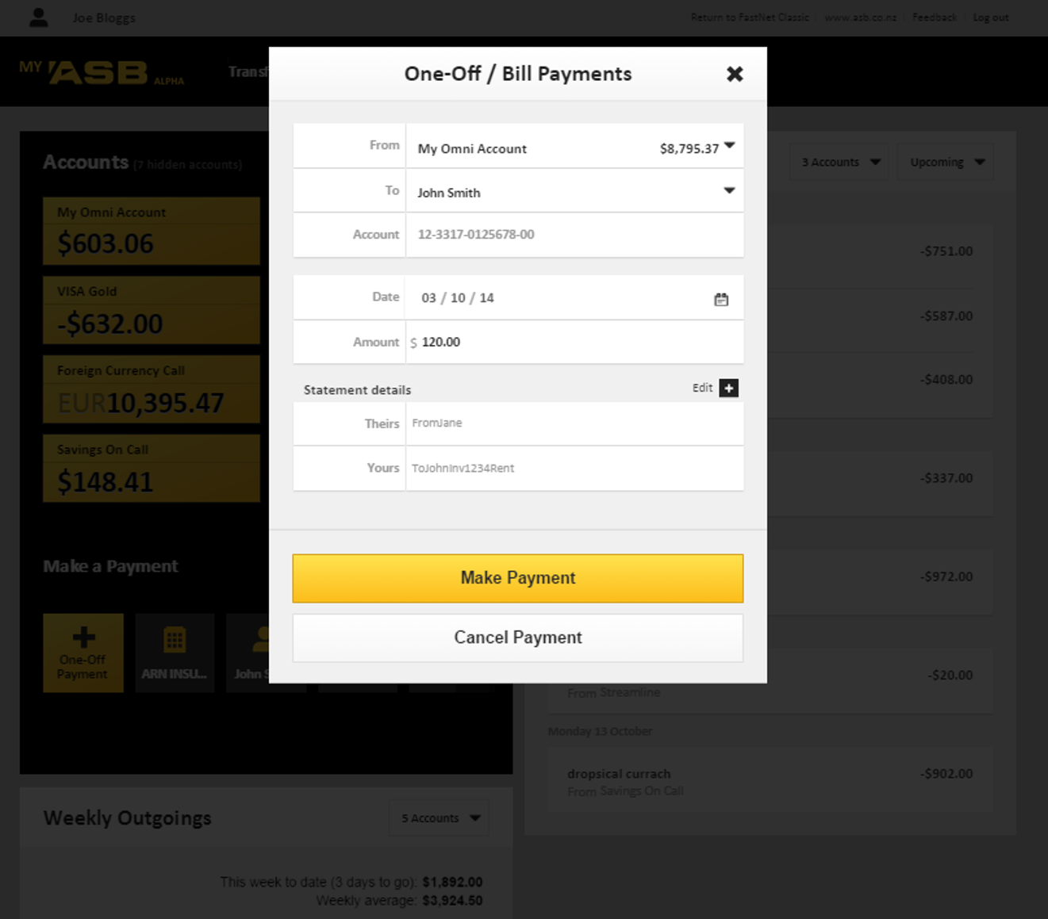
Notes:
…can also be presented as modal popups (lightboxes)

Slide 29
Digital Sales
Fulfilment
Notes:
Most recent Atlas deployment to go to Production. Suite of application forms for applying for various ASB products

Slide 30
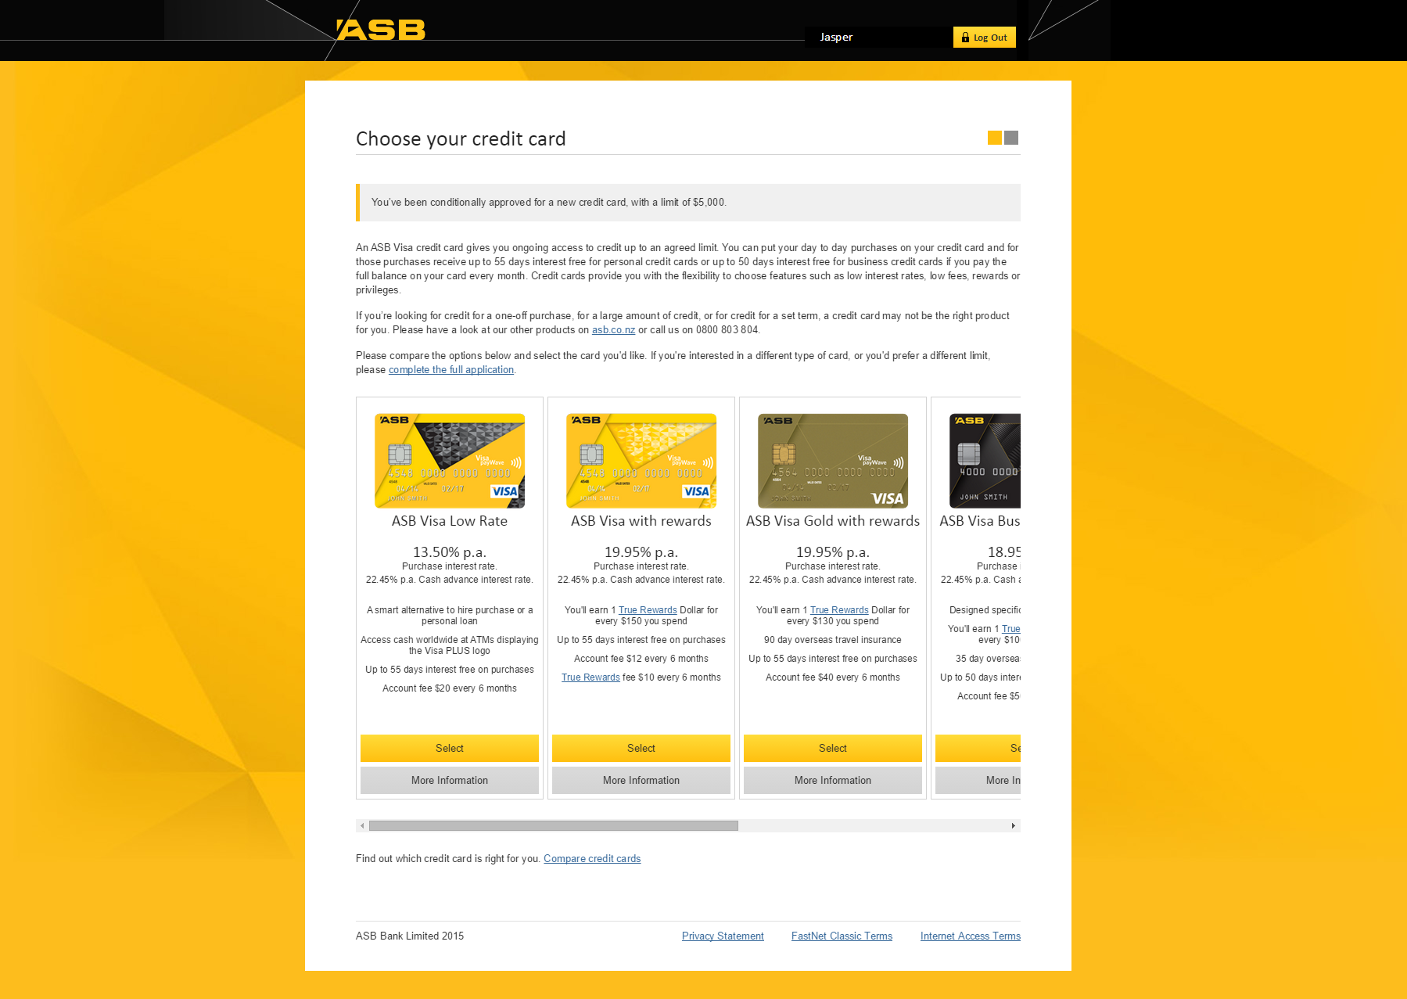
Notes:
Example: CALs – applying for credit cards (pre-approved limit). Single-page Feature with multiple views.

Slide 31
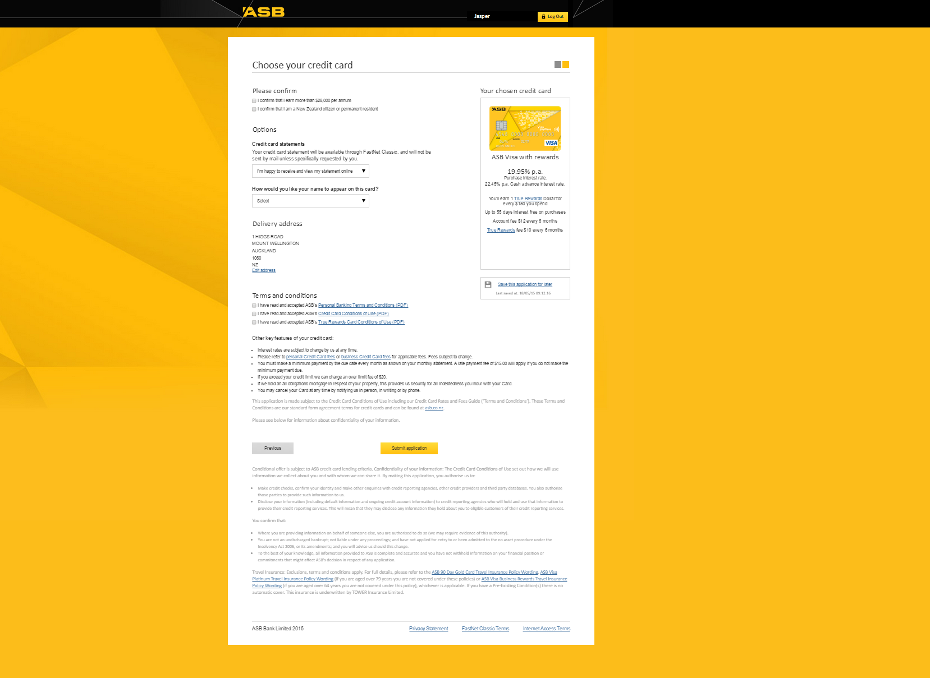

Slide 32
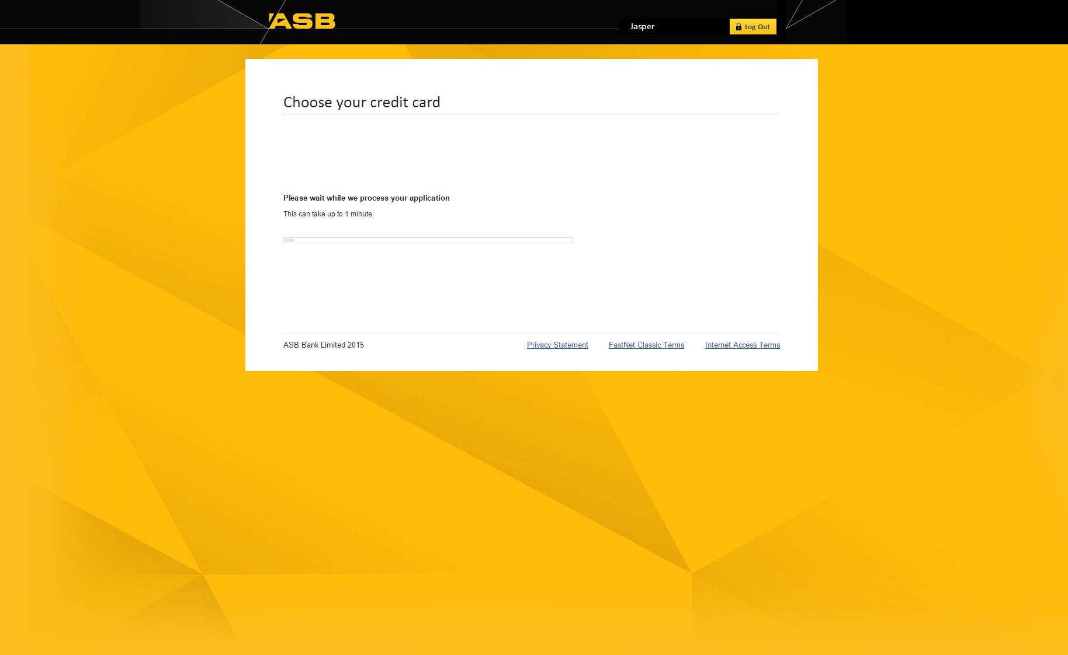

Slide 33
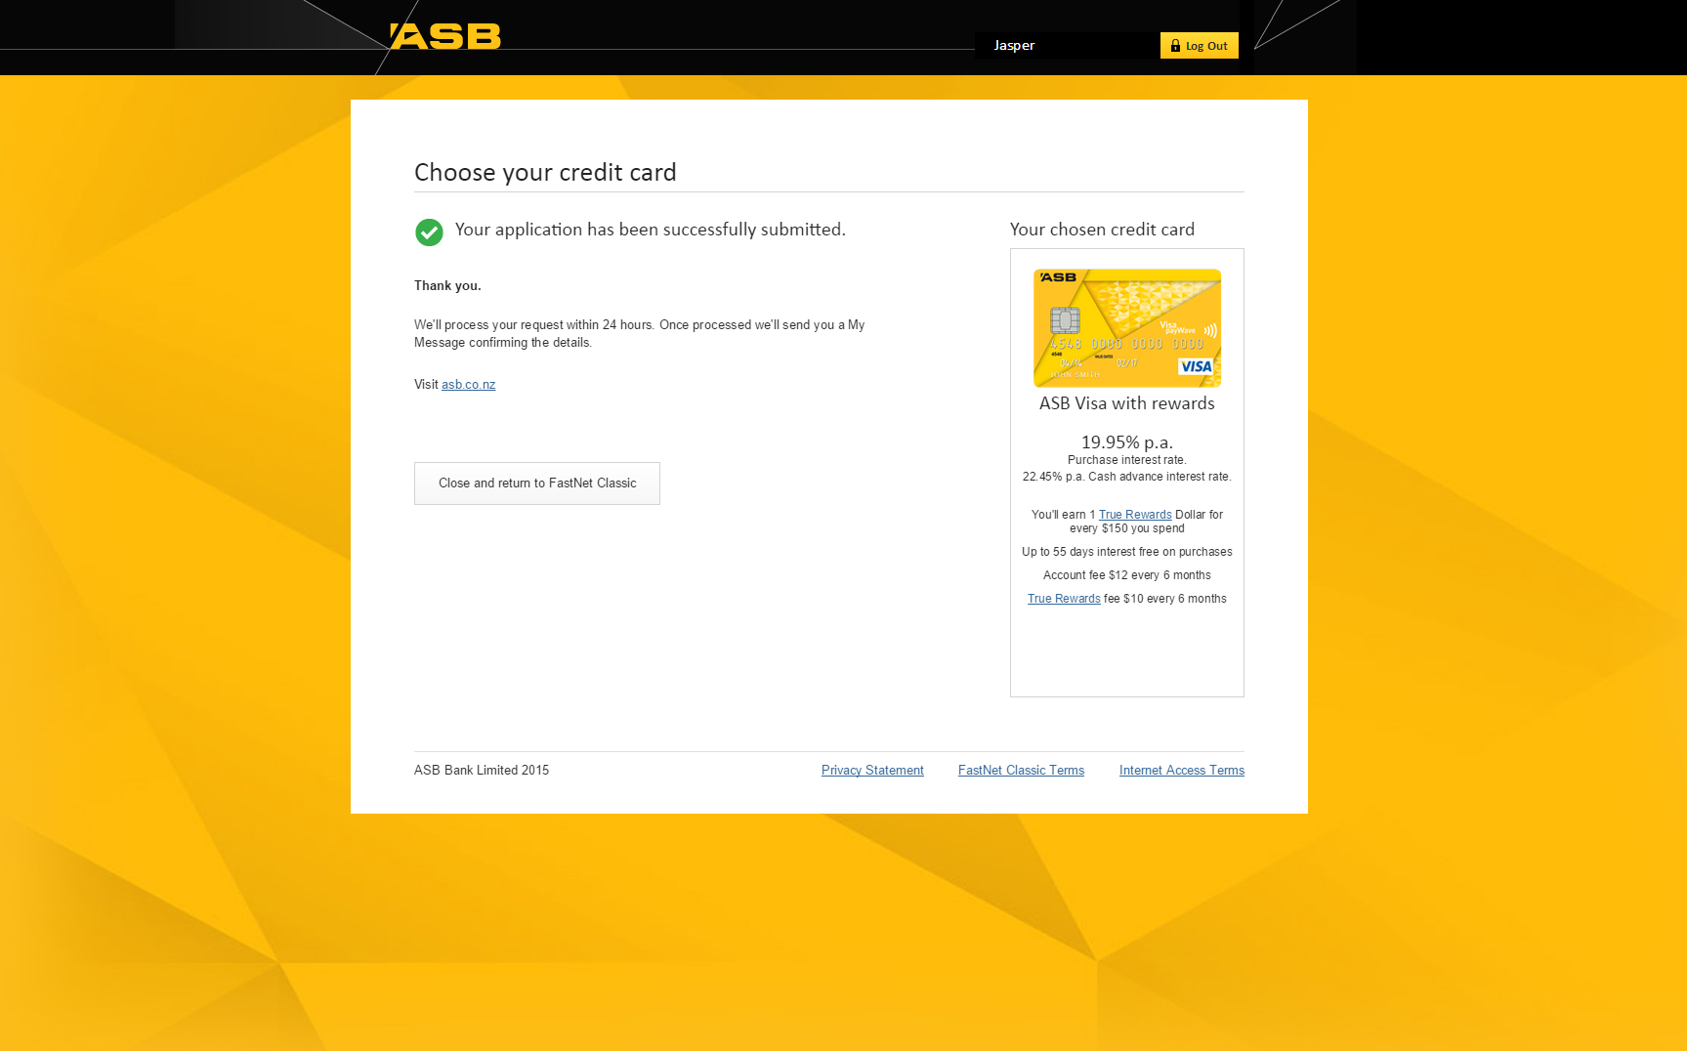

Slide 34
Next: Ben

Slide 35
Atlas Platform

Slide 36
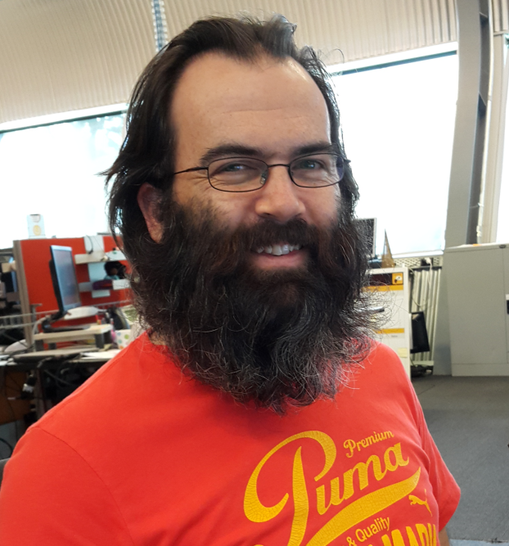

Platform Team
Paul Palmer
Ben Hugo

Slide 37
Atlas Platform
Container
5
1
2
IAM
Platform Services
Feature 1
Feature 2
3
Transactions
Payments
Product-Requests
Accounts
Transfers
Products
…
Feature 3
Layer 7 (APIs)
4
Middleware
HOST
Onyx

Slide 38
Platform Services
Container
5
1
2
IAM
Platform Services
Feature 1
Feature 2
3
Transactions
Payments
Product-Requests
Accounts
Transfers
Products
…
Feature 3
Layer 7 (APIs)
4
Middleware
HOST
Onyx

Slide 39
Platform Services
1
Themes
Configuration
Tokens
Container Settings

Slide 40
Platform Services
Configuration
Themes
2
Tokens
Container Settings

Slide 41
Platform Services
Configuration
Themes
3
Tokens
Container Settings

Slide 42
Platform Services
4
Configuration
Themes
Tokens
Container Settings

Slide 43
Microservice Framework
Microservice
(Nuget Package)
Generic CRUD
Authentication Modules
?
Generic CRUD
Logging

Slide 44
Existing Microservices
Platform Services
Enterprise Microservice
Logging Microservice
Auditing Microservice

Slide 45
Microsoft Release Management
Development
Testing
Production
1
2
3
One Click Deployment

Slide 46

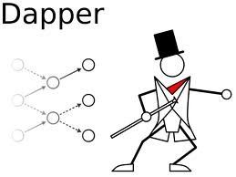
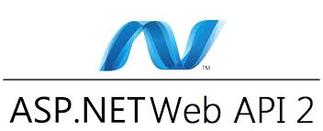



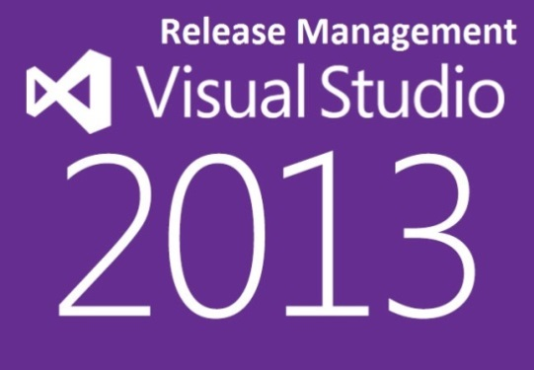
Technology Stack

Slide 47
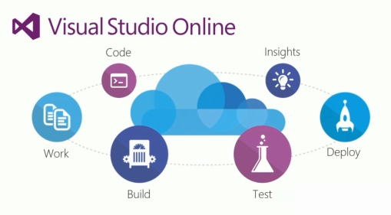

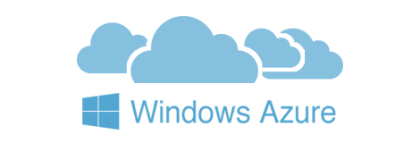
What next?

Slide 48
Next: Gupreet

Slide 49
IAM

Slide 50
Identity & Access Management (IAM)

Slide 51

Vision?

Slide 52

Single front door

Slide 53
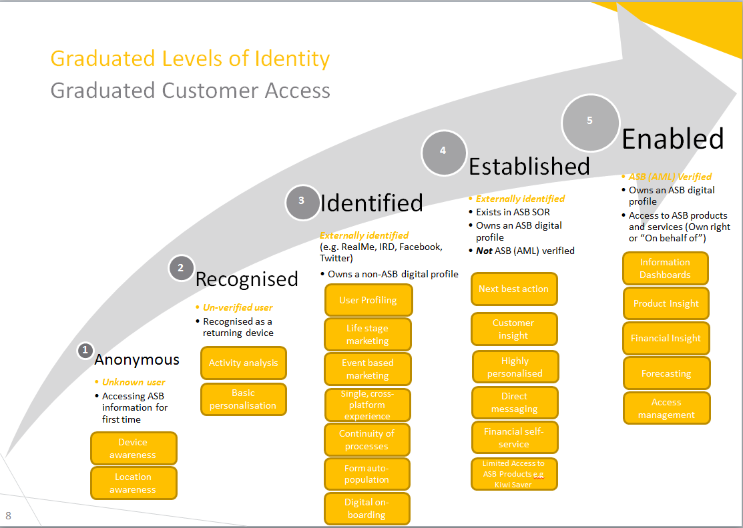

Slide 54

Technology transition

Slide 55
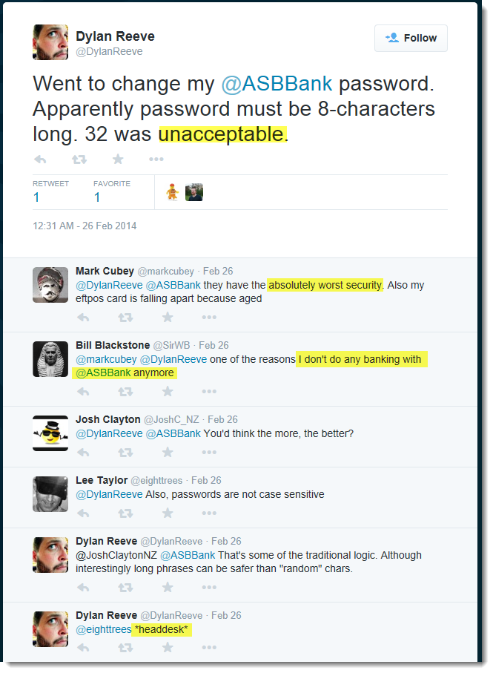
Password length

Slide 56
How?
IBM Security Access Manager (ISAM)
Phased approach
Initially for FastNet Classic and Online Share Trading applications

Slide 57
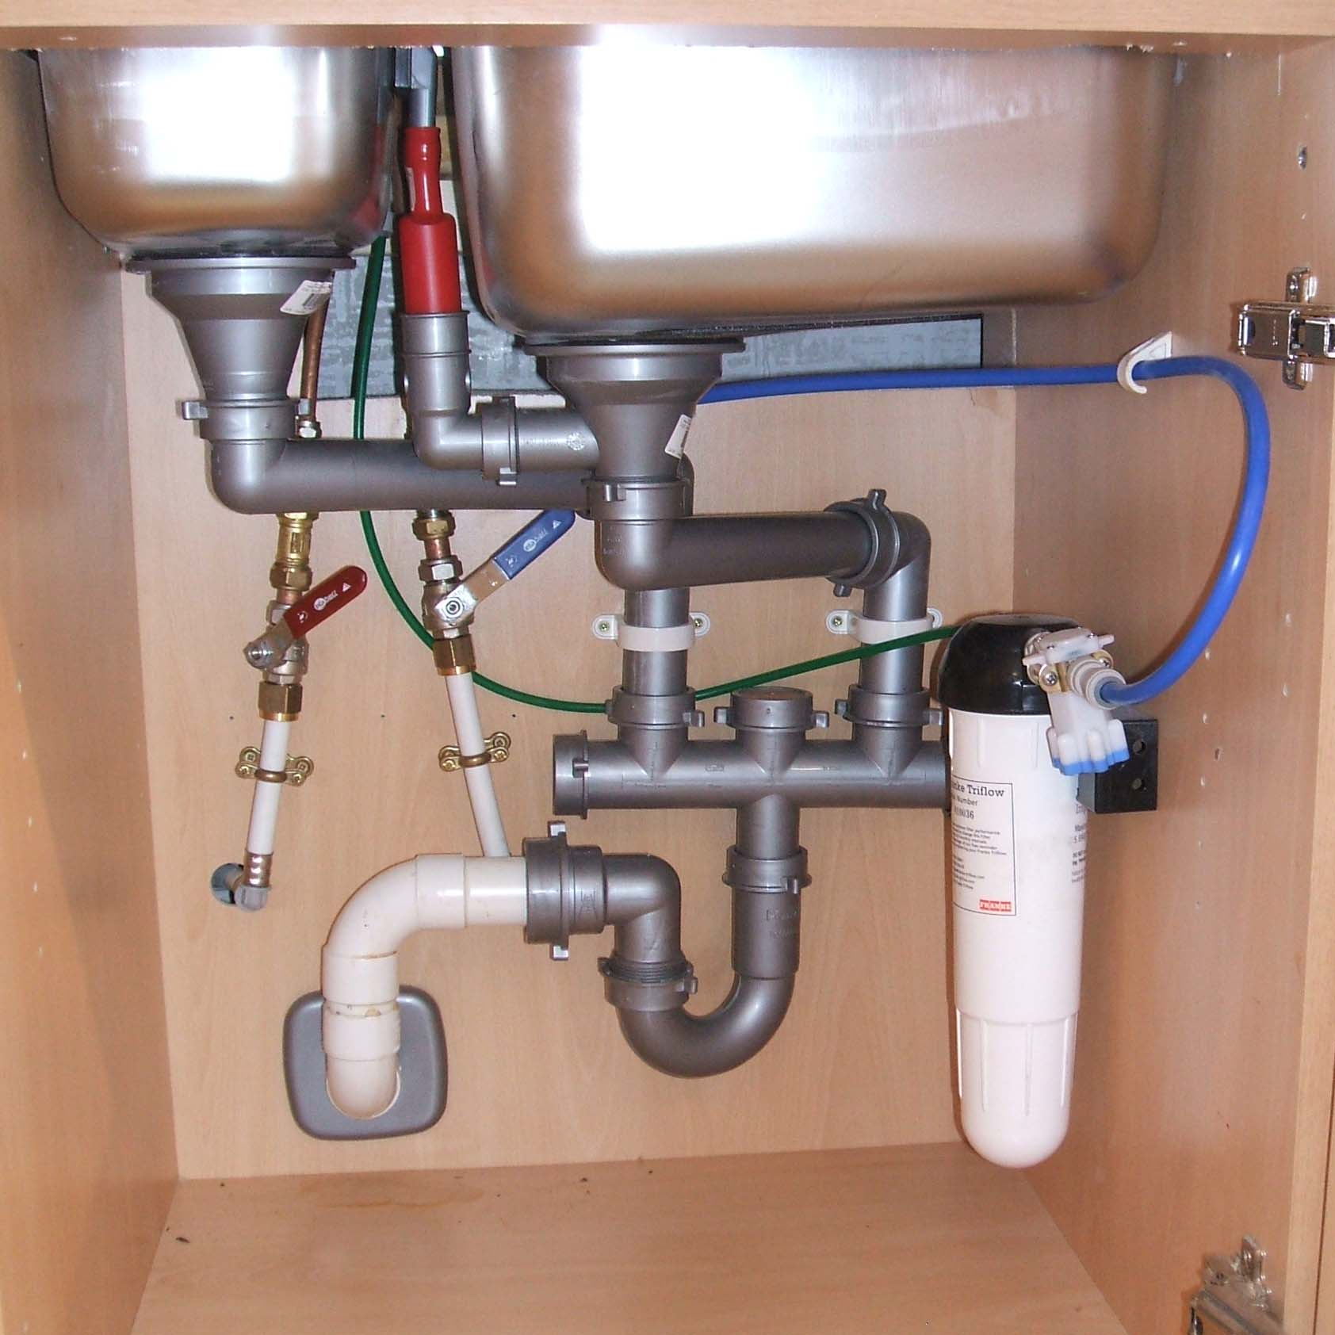
Legacy Integration

Slide 58

Performance

Slide 59
Next: Patrick

Slide 60
Fastnet Classic

Slide 61


True Rewards
Notes:
Visa Business Rewards
Business True Rewards

Slide 62
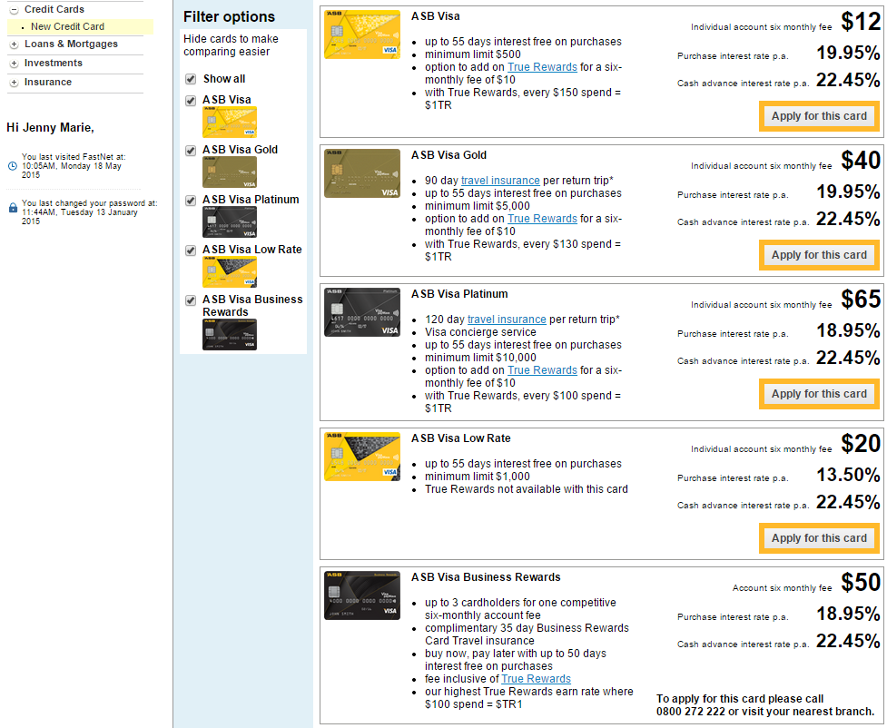

Slide 63
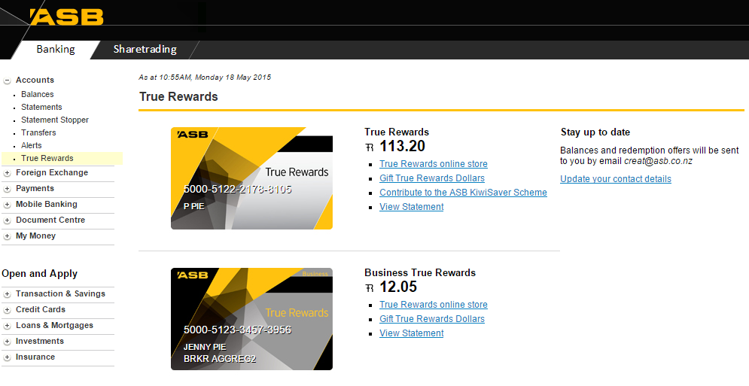

Slide 64


Digital Acceptance
Notes:
Digital acceptance for loan documentation, enabling STP loan advances.

Slide 65
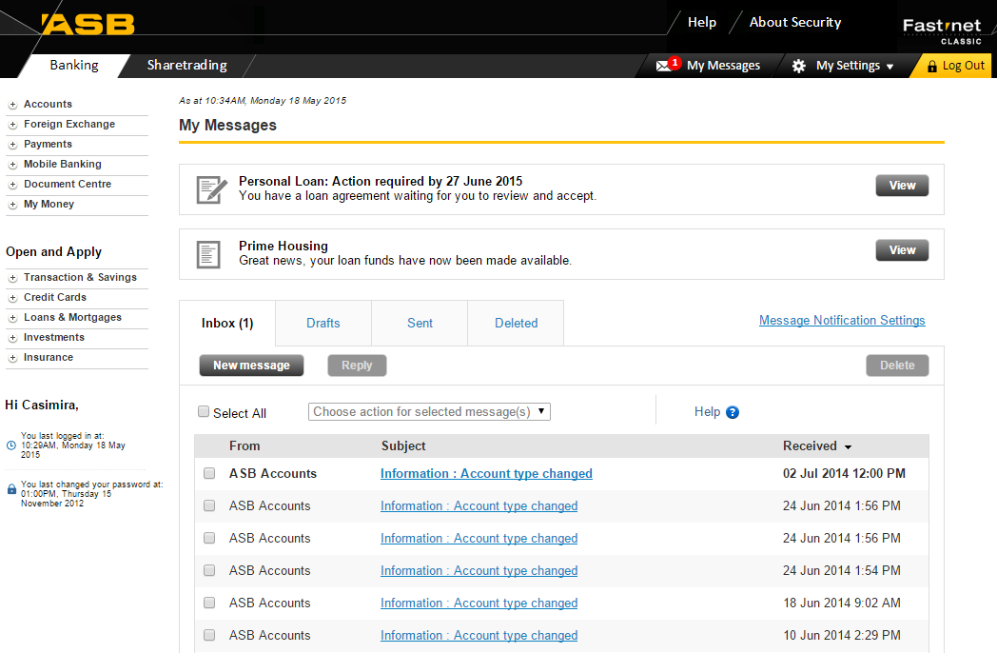

Slide 66
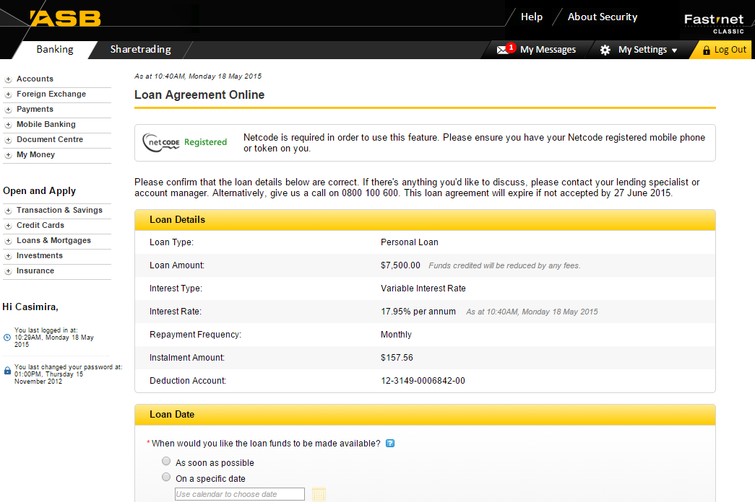

Slide 67
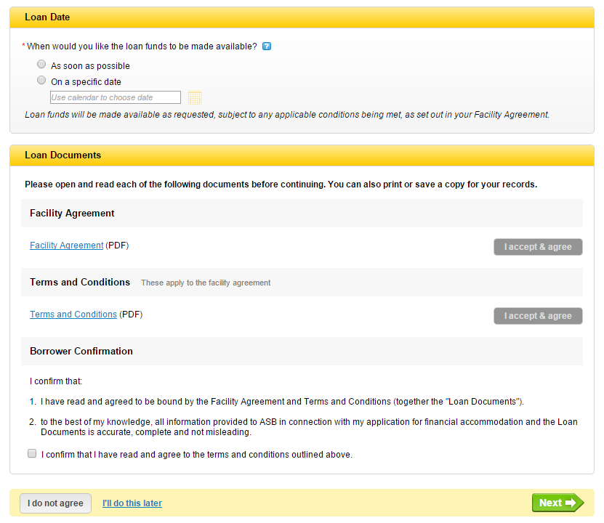

Slide 68


Online Share Trading
Notes:
2 new markets (NZAX and ETFs) to Online Share trading.
Previously, these 2 markets could only be traded on by phoning ASB Securities.

Slide 69
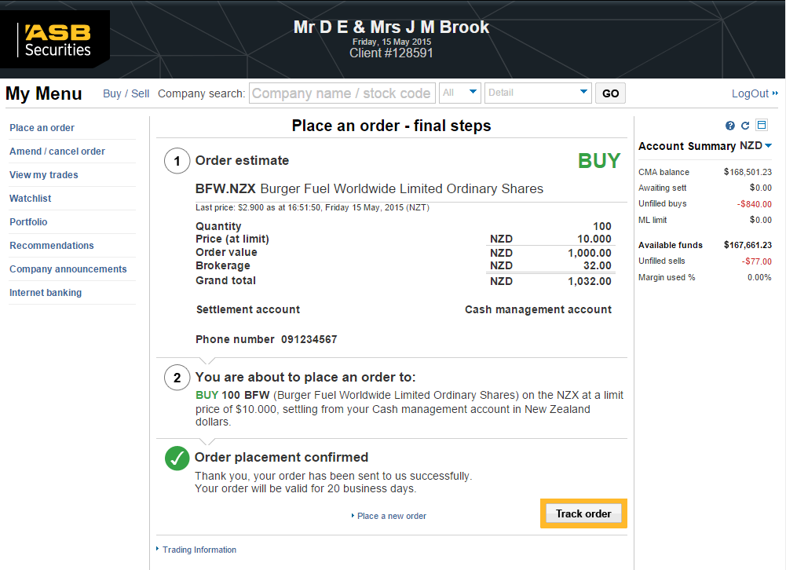

Slide 70



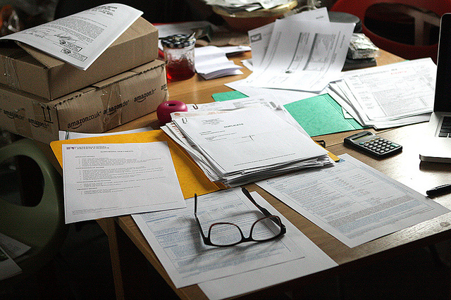
Pre-assessment Limit (PALs2)
Notes:
Individual Orbit Home Loan PALs across the FNC and Onyx channels.

Slide 71
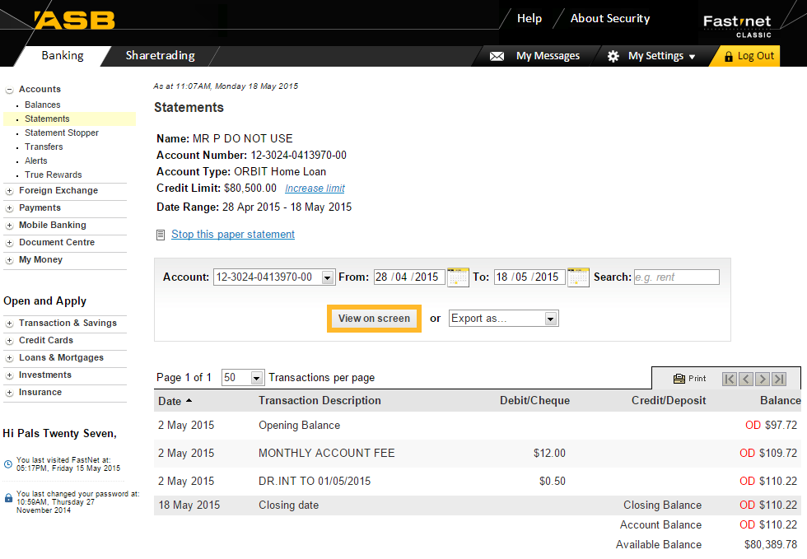

Slide 72
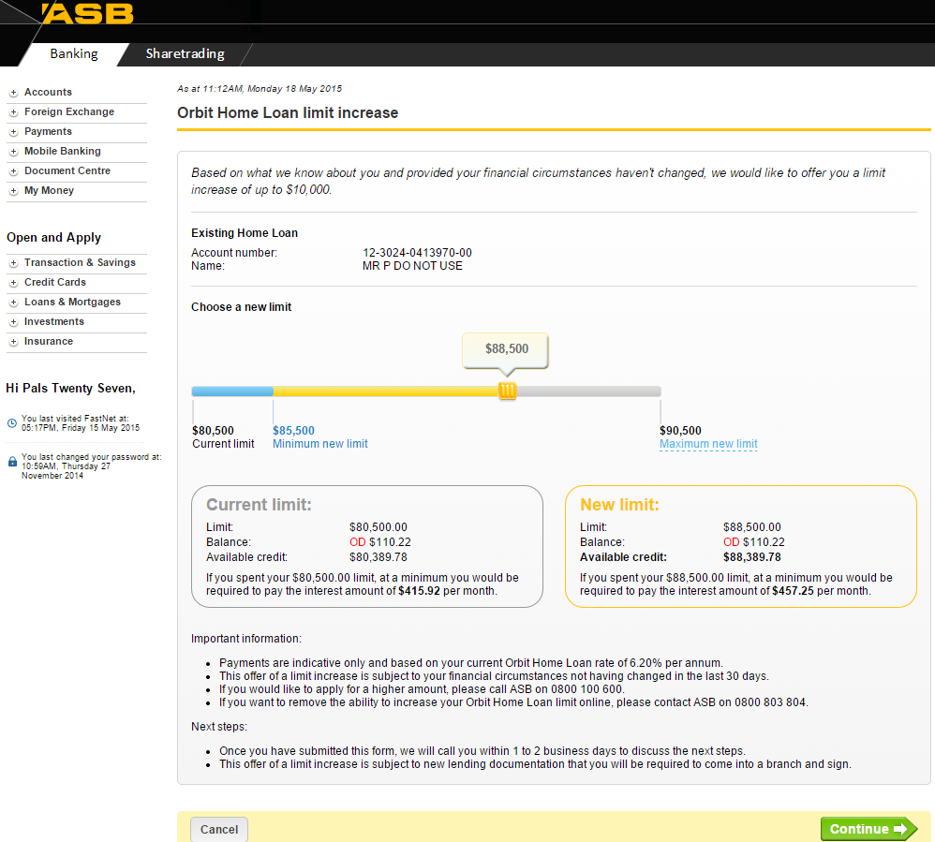

Slide 73
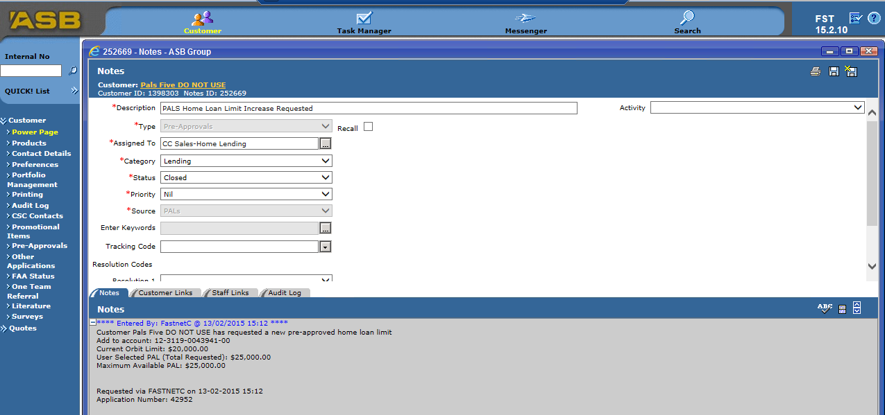

Slide 74
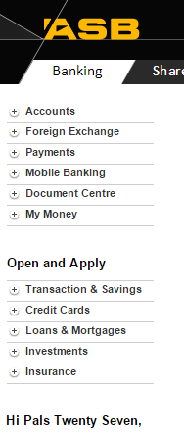

Left Hand Menu
Notes:
FNC left menu enhancements to better surface sales opportunities and digital sales capability

Slide 75


Site Catalyst
Notes:
Links Tracking on the Balances page
Application Forms Tracking under Open and Apply

Slide 76
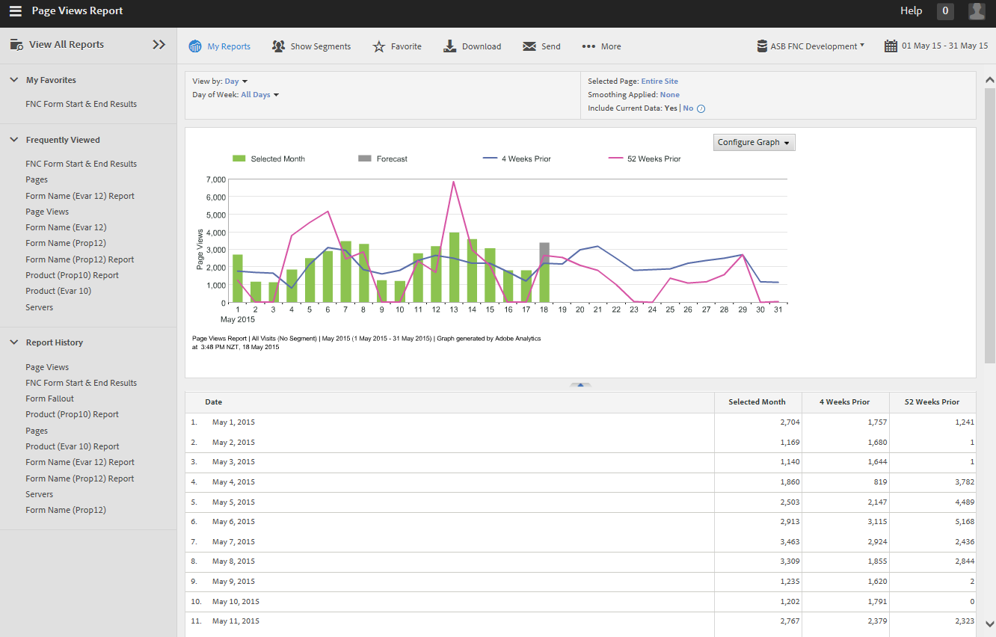

Slide 77

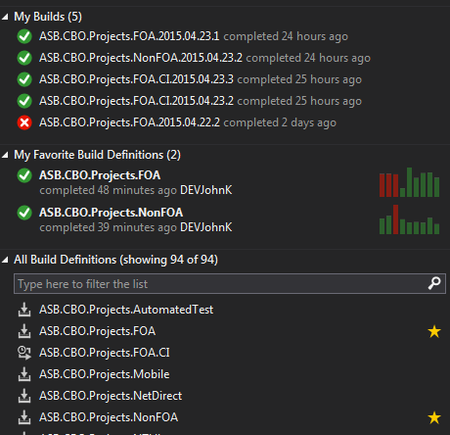
Automation Build
Notes:
Automated build and deploy process for FNC builds
TFS & Octopus

Slide 78
Next: Andy

Slide 79
3rd Party Integration

Slide 80



Third Party Integration “To improve the life of the small business customer”

Slide 81



Slide 82
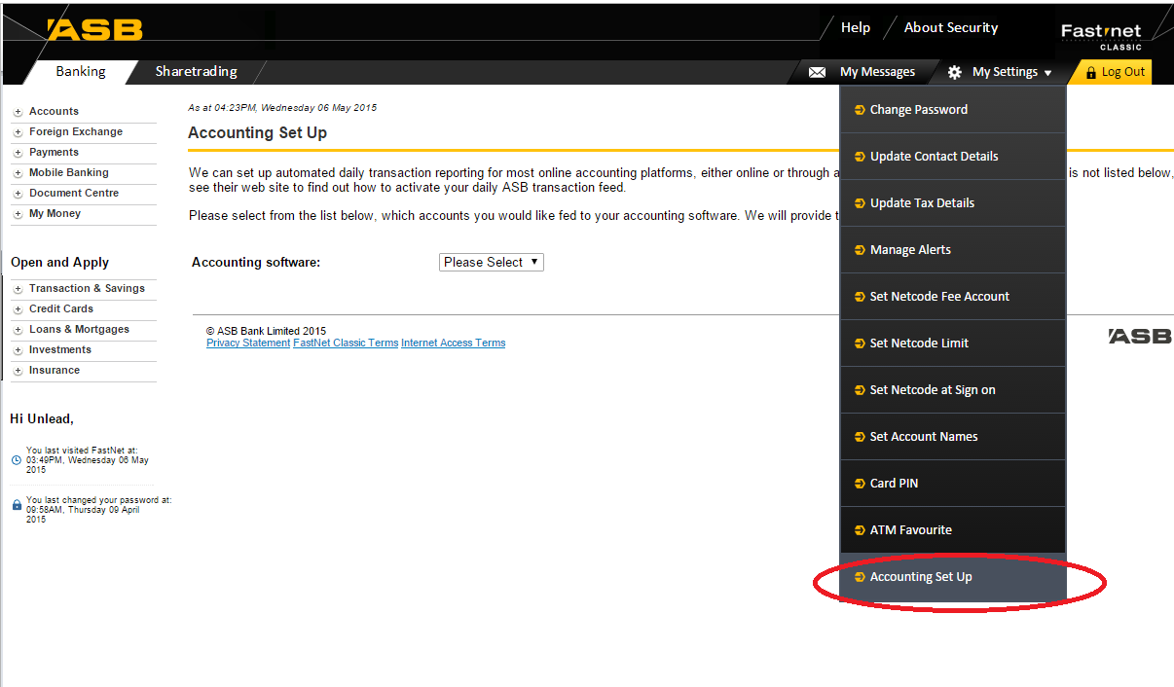

Slide 83
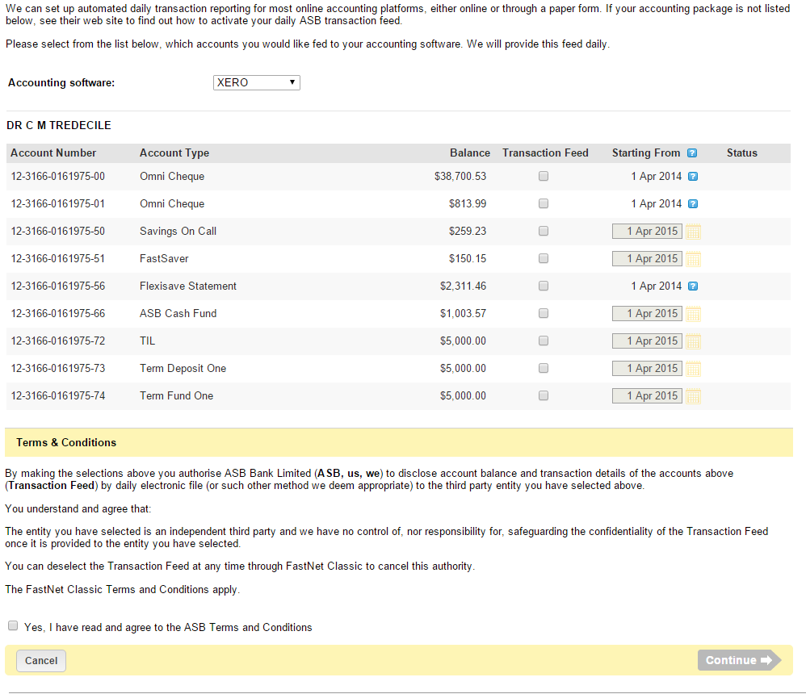

Slide 84
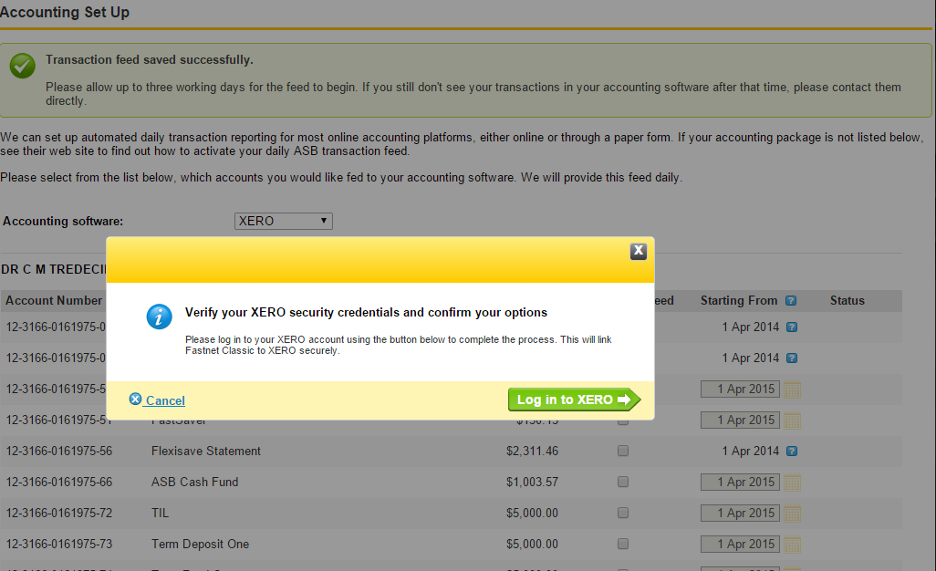

Slide 85
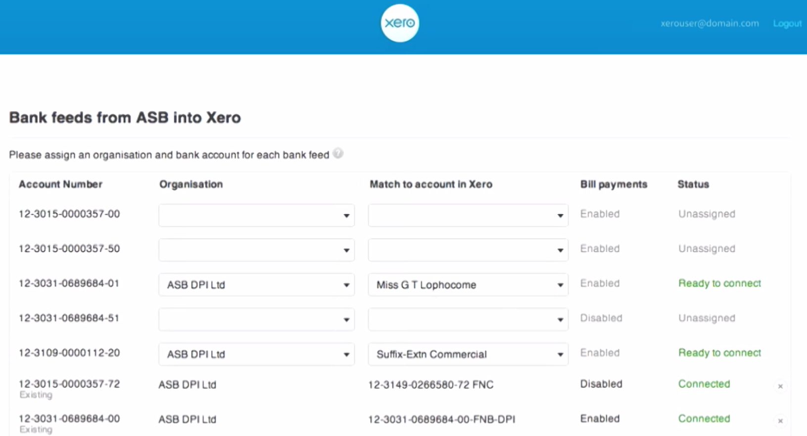

Slide 86
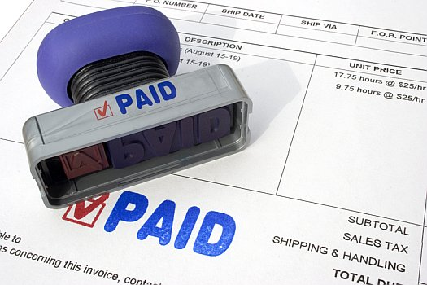

Slide 87
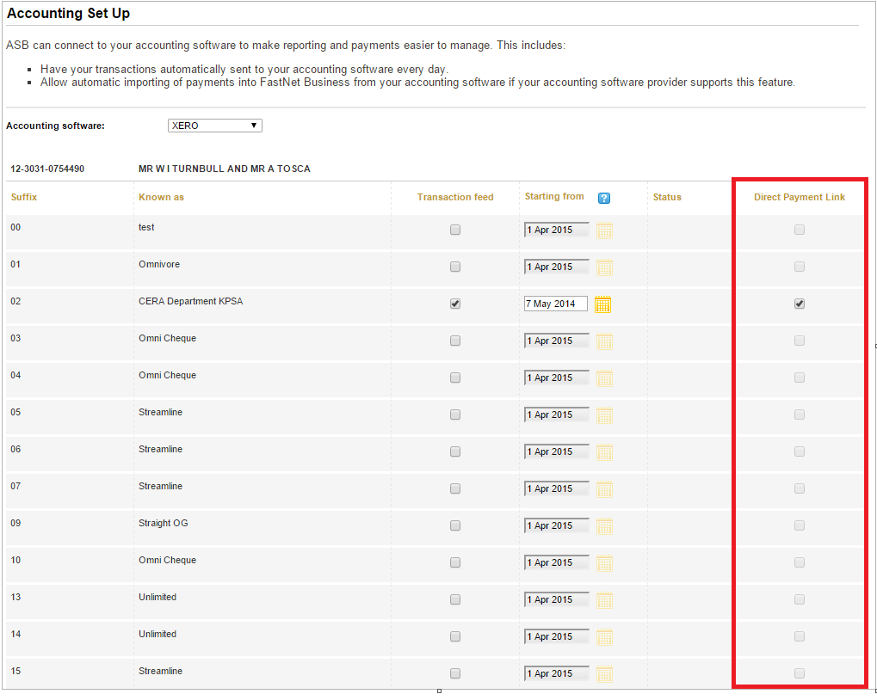

Slide 88
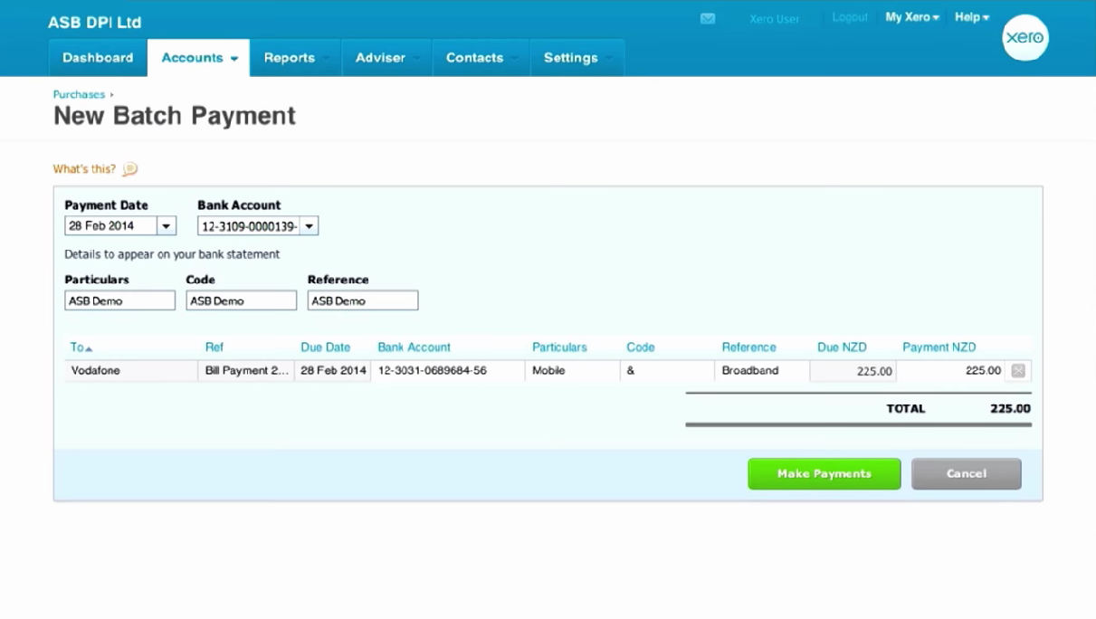

Slide 89
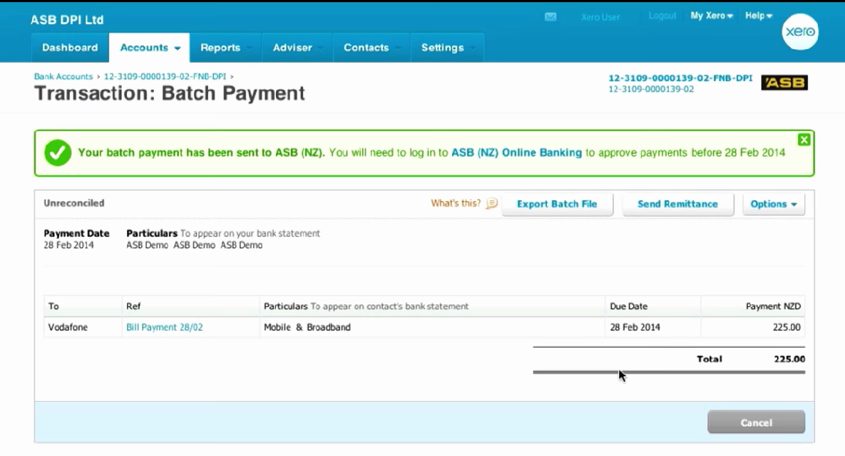

Slide 90
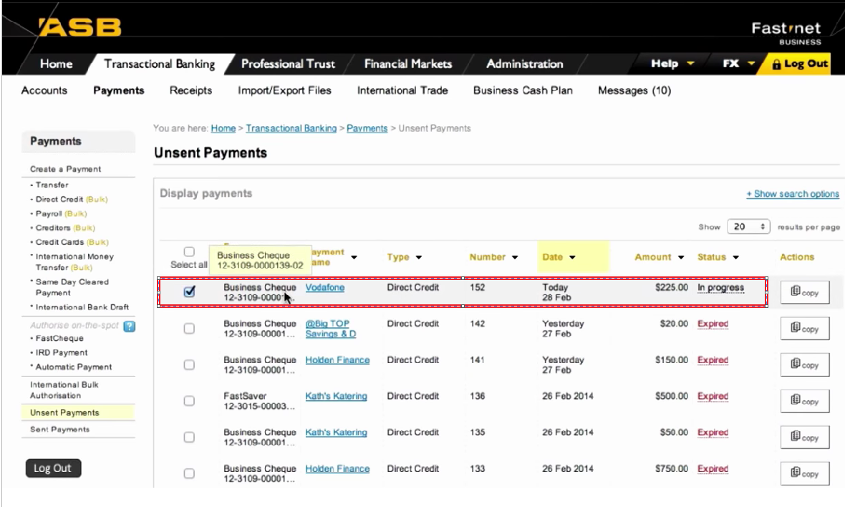
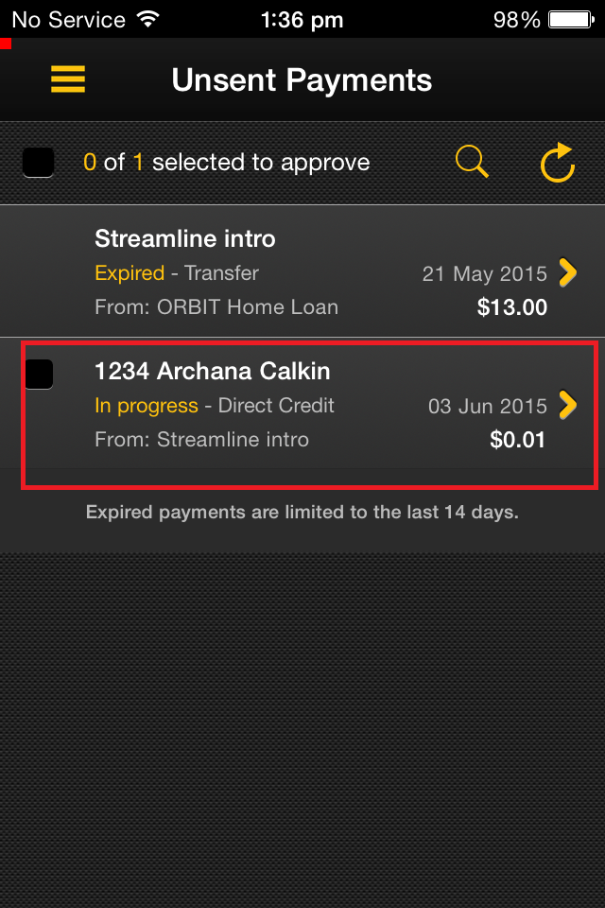

Slide 91
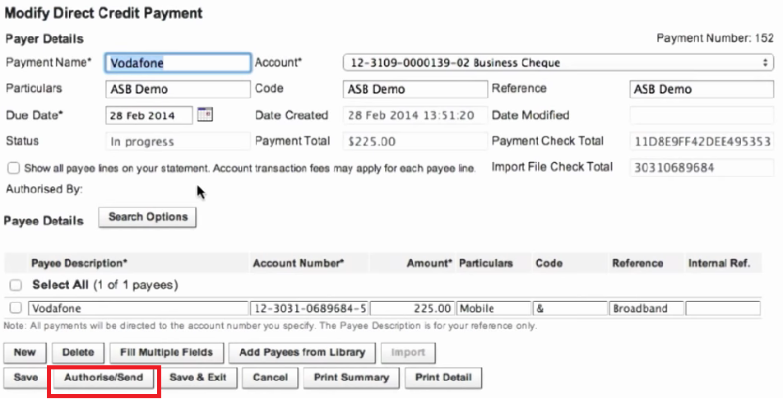
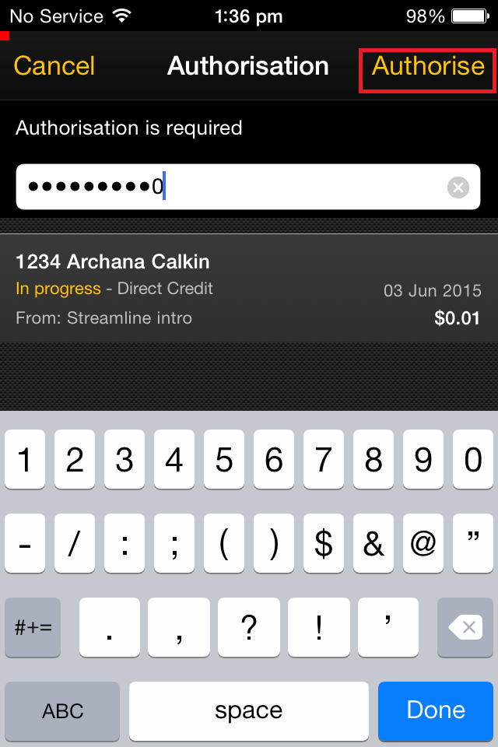

Slide 92
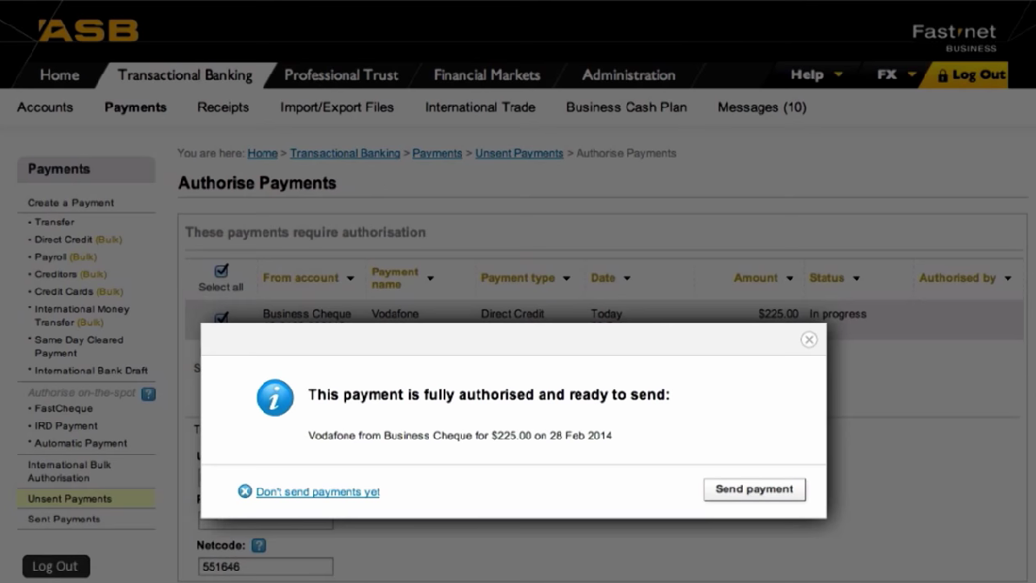
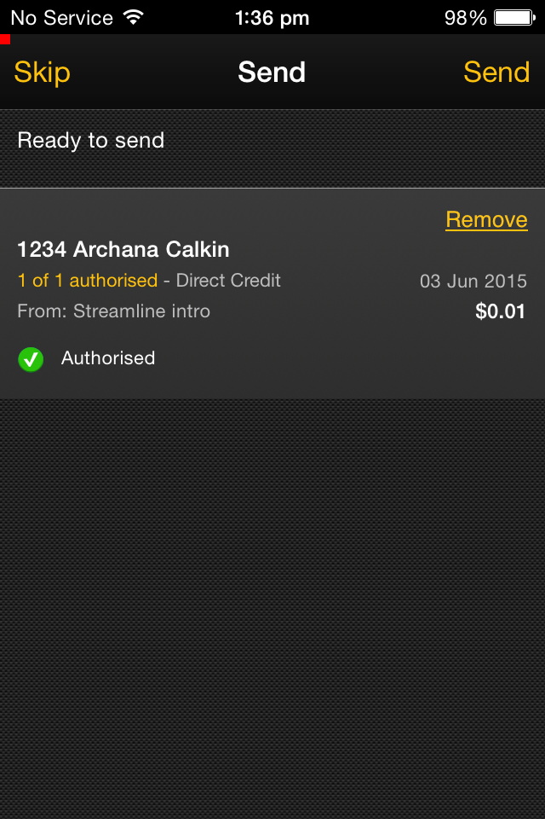

Slide 93

“To improve the life of the small business customer”

Slide 94
Next: Rhys

Slide 95
ASB Mobile

Slide 96





64 % | < 2 % | 34 %
ASB Mobile
ASB Business
100,000’s | 1000’s
Notes:
Mobile Team
- Two teams - Team A (Awesome) Team B (Brilliant)
- 3 platforms
To product:
- ASB mobile (Mojo)
- ASB Business (BOSS)

Slide 97






Continuous Integration
Notes:
VS + TFS
- Server side Builds
- Windows Phone Builds
- Git repo (hosted on TFS) for Android + iOS
- TFS repo for Server Side and Windows Phone
Octopus Deploy for Server side
Jenkins + Gradle for Android build
Xcode Bots for iOS builds

Slide 98
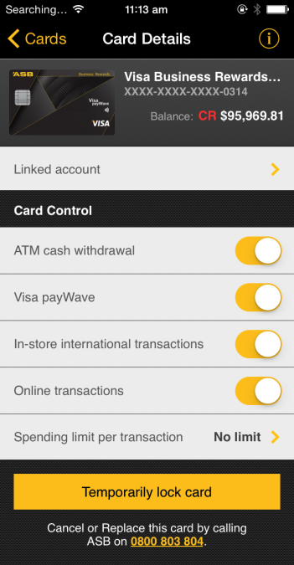
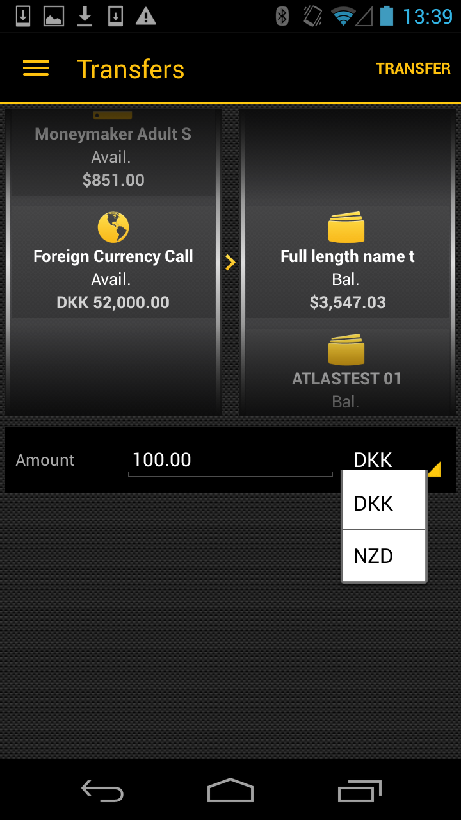
Latest Release
Card Controls
FCA Transfer
Notes:
Release 3.5
- Card controls - Turning different card features on and off - Card PINNING in 3.6
- FCA (Foreign Currency Accounts) - Transfer money between different accounts

Slide 99

Future: Wearable Devices

Slide 100
Next: Ragha

Slide 101
Loan Top-Ups

Slide 102

Loan Top Ups - Digital Acceptance
Customers can Top-Up an existing Home Loans or Personal loans by digital accepting the documents in Fast Net Classic

Slide 103

Loan Top Ups - Digital Acceptance

Slide 104

Loan Top Ups - Digital Acceptance
Application List Service :

Slide 105

Loan Top Ups - Digital Acceptance
Application Details Service :

Slide 106

Loan Top Ups - Digital Acceptance
Record Customer Action

Slide 107

Loan Top Ups - Digital Acceptance
Assess STP Advance :

Slide 108

Loan Top Ups - Digital Acceptance
STP Advance :

Slide 109

Loan Top Ups - Digital Acceptance
STP Advance Reject and Loan Documents Stitched successfully :

Slide 110
Next: Yini

Slide 111
2K3 Upgrade

Slide 112

14 July 2015
Notes:
MS server 2003 end of life is approaching.

Slide 113







Notes:
Leading next:
I am going to talk about only one site – ASB Web.

Slide 114

Notes:
Before I started, my initial reaction was – what is the big deal? It is only websites.
Then I heard rumours such as – no doco, no overarching architecture, ad-hoc dev, missing source code, com+, vb6, nobody has definite knowledge of asb web, etc.
So, what does it look like?
Size – 2600+ links, 200+ components, ~20 connection strings, ~12 databases.
Lifespan – dated back in 2002 to current.
Mix of technologies – com+, vb6, c#, .net1, .net2, java.
Deployment – file copy, dynamic publish real-time to PROD.
Ownerships – different business units own different parts of the site.
It is supported by only two devs.
Because of what I heard, I started to build up this assumption that ASB Web is difficult, not-understandable, messy, spaghetti.
But wait a minute, how can two developers handle this massive site with no documentation, no source code, no architectural structure?!
Leading next:
That made me want to take a closer look, and the more I studied it, the more I felt ASB Web is actually a hybrid microservices!

Slide 115

“
”
Notes:
It looks like a hybrid microservices because:
ASB Web is consisted of 200+ small apps.
Each folder under the site is actually an app, some big, some small, each one is responsible for one business feature.
Most of these apps are simply static contents. Complicated ones all have source code in TFS. So no doco, no problem, just look at the source!
They use different languages but mainly in Microsoft stack.
Apps can be deployed separately. Some deployed straight to PROD.
I am not saying that ASB Web is strictly a microservices architecture. But by changing my mindset, I was able to see things differently therefore tackled the problem from a completely new angle.

Slide 116





Careers
ASB Football
Social banking
Multiple languages
Bus focus
contactless
Auckland Summer

Slide 117



Testing
Manual test
Test server
Notes:
After we finished the upgrade, we needed to test it
It is massive, no selenium auto test scripts.
Testers need to prioritize their test cases, test manually by priorities.
Need a quick, automated sanity check on all links.
How did we do that? IIS logs
We wrote a program to:
Step1 extract all the urls that hit ASB Web and summary them by hit count.
Step2 reconstruct those urls and hit our test server to see if any mismatch.
But one problem: IIS log files are huge!
Across 24 machines, each machine has 700+ logs, each log ~48mb, total of 100+GB per month.
Over 7 million urls per month that hit ASB Web.
First try step1 – 4 minutes per log. If run non-stop 24hr a day would take up to 46 days to parse only one month’s data.
So I tweaked the program a bit cut it down to ~6 hours. But this was still too slow.

Slide 118

50MB p/log, 100GB p/m, 12 months
4minutes p/log, 46days p/m

Slide 119

Notes:
Async has come to rescure. Cut it down to ~2 hours.

Slide 120

What you believe is what you see
Notes:
Takeaway:
Not often we get to do something from ground-up, using latest technologies.
Quite often, we get to work on something old, and not-so-fancy.
So when we are faced with legacy applications or a problem, we should listen carefully but don’t let assumptions affect what we see.
And maybe VB6 is not that bad after all because it at least does not have semi-colon and if we choose to believe it.

Slide 121
Next: Luke

Slide 122
Onyx

Slide 123

Meet Joe…
Notes:
So, we’re starting off the next set of slides by doing some role playing
I’m going to ask you to put on Joe’s shoes.
Who is Joe? Joe is a bank teller / customer services guru working at ASB.
You interact and help clients out on a daily basis.
You
Open loans,
Check facts
Get quotes
Check Rates
Push envelopes,
Collaborate with colleagues over client’s information
And the list goes on and on.

Slide 124

Frustration
Notes:
Imagine you had to do all that work, manually, the old fashioned way
Can you imagine the frustration both yours and the client you’re facing?
So much tedious work so many hours laboring over your desk till 1 in the morning.

Slide 125

Notes:
We all know the answer to every bank teller’s daily conundrum.
And that is a software package which can handle most of Joe’s work from a day to day basis
Meet Onyx.
Onyx is a client relationship manager software from with which we can save Joe and make our clients happy.

Slide 126

Moving away from the old…..
Notes:
A bit of history about Onyx, before we move on to what we’re actually doing
Onyx, was built 11 years ago, by a company called as you may have guessed, ONYX.
ASB, bought the off the shelf product and has since heavily modified it.
This has worked fine for the past decade but time is running out, for the technology that was used to build this product
Which leads us to what we’re currently doing within ONYX….

Slide 127

The Upgrade..
Notes:
Ever since it came out, Windows Server 2003, has been used to host ONYX,
However as my colleagues have mentioned before me, support is running out and it will finally end in July this year.
That has lead the team to upgrade Onyx to later technologies for it to be supported by later Oss
Which leads us to the following

Slide 128






Progress so far
Notes:
There is much going on at the moment and much more to do for instance
We are upgrading from .NET1 to .NET4 so that the project can sit better on newer Oss
We are moving away from VBScript and .HTC Files (dynamic html behaviors) towards Javascript
We upgrading the GUI
And finally we are moving towards Octopus Deploy.

Slide 129

Challenges
Notes:
As many may assume, such big changes do come with their own problems
For instance, we’re ensuring that converting all VBScripts to JS, goes smoothly into the next version.
Fixing holes the upgrade may have introduced.
Ensuring the Octopus is used right due to the many parts of the project, etc
Apart from the technical issues there is also soft problems such as Domain Knowledge.
Despite all these problems, the project should be intime for the July deadline
Now, on to, new projects currently being developed for Onyx.

Slide 130

Tiered Pricing
Notes:
The Latest functionality addition to onyx is regards home loans.
Restrictions imposed by the RBNZ on home Loans as of October 2013.
Fewer home loans are available for customers with smaller deposits.

Slide 131

Rates / Margins / etc
Notes:
Customers with an LVR (Loan to Value Ratio) of 80+% will be charged a Low Equity Fee / margin on top of their existing rate.
Example:-
If you are buying a home for $100,000 and you have $20,000 for a deposit; the remaining $80,000 you need to borrow is 80 per cent of the home’s total value - making your LVR 80%.
The customer’s LVR is checked against pre-defined margin rules where he/she is charged according to their LVR.
The higher the LVR the higher the fee.

Slide 132

Notes:
Numbers
Project started on the February 18th.
124 days originally estimated for the project.
36 days ahead of schedule on development.

Slide 133

Challenges
Notes:
Challenges
Understanding the project specifications
Little structure in code

Slide 134
Questions…

